Slide 1
Introduction to Selenium
Introduction to selenium
Selenium Architecture
Software requirements

Slide 2
Introduction to Selenium
Open source test automation tool
Key components of selenium are Selenium Webdriver, Selenium IDE and Selenium Grid
Can be used for only web testing
Supports wide range of browsers(chrome, safari, Mozilla, IE, etc)
Supports multiple OS and multiple programming language(java, C#, Python etc)

Slide 3
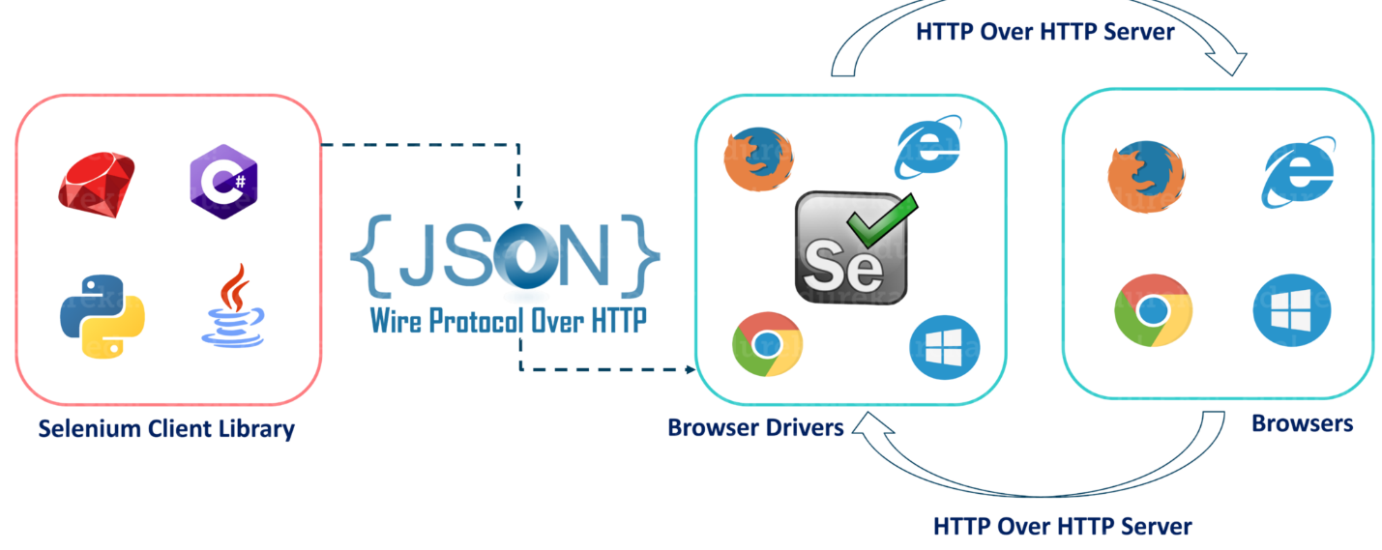
Selenium Architecture

Slide 4
Explaination
Selenium client library is nothing but the programs that we had written in various programming language.
Once the test is triggered, code written will be converted to Json format
Generated Json will be sent to Browser Driver through http protocol.
Each browser will have its own drivers
Drivers will communicate with the respective browsers and execute the commands by interpreting Json received from the Client.
Browser driver will receive response from the server and send it to the client in json format.

Slide 5
Software Requirements
java 1.8 or above
Eclipse is the IDE to write and execute programs. Other IDEs can also be used
Maven libraries to create Maven Projects with dependencies
Browser drivers and web browsers

Slide 6
Project creation in Eclipse
Open Eclipse
Go to File and click on New. Select Java project.
Enter the details like name of the project and click on Next.
Click on finish to complete and the project will be created
To get the libraries, convert the project to Maven

Slide 7
Configuring Maven libraries and dependencies
Right click on the project in the eclipse
Click on configure and select convert to Maven project
Enter the group id and artifacts and click on finish
Open the pom.xml
Visit the maven site
Search for selenium
Select selenium with java
Click on the latest version of the package
We can download the jar and configure the libraries in eclipse, but the preferable method is to copy the dependency and update that in pom.xml.
All the libraries will be imported to Maven dependencies folder

Slide 8
Commands to Set Java_Home in MAC
vim ~/.bash_profile
export JAVA_HOME=$(/usr/libexec/java_home)
Hit Esc and then :wq and then ENTER
source ~/.bash_profile
echo $JAVA_HOME

